Slide 1


Supervised By
Prof. Md. Zulfiquar Hafiz
DROID SCANNER
AN APP SECURITY MANAGEMENT SYSTEM
Presented by:
Salsabila Zaman1443
Md. Shaikhul Islam 1438
1

Slide 2

ABOUT DROID SCANNER
It is an android app security tool which provides-
Full Scan (all apps) | Quick Scan (specific app)
Malicious App Detection
APK Extraction
Security Reports: Permissions, intents
User and Developer dashboard
Database tracks scan history & security records
Custom App Management
2

Slide 3
What Sets Droid Scanner Apart?
Achieves High Accuracy with Fewer Features
Faster and More Efficient:
Lightweight Database
More Transparent and Explainable:
Real-Time Ready & Device Scanning (Future Update)
3

Slide 4

PROCESS
Login/Registration
Main Window
Scan
Report
Dashboard
Quick
Full
Apk file
Profile Update
Scan
AppLists
4

Slide 5
CHALLANGES
Extracting Features from APK Files
Training & Optimizing the Machine Learning Model
Making Large-Scale Scans Efficient
Ensuring Secure Data Storage & Privacy
Designing a Smart Whitelist & Blacklist System
Building a User-Friendly PyQt5 Interface
5

Slide 6

FUTURE SCOPE
Enhanced Behavior Analysis – Track network & hardware interactions
Expanded Dataset – More permissions, intents & behaviors
Real-Time Threat Detection – Scan during installs & updates
Continuous Security Updates – Evolving with Android threats
Optimized ML Model – Accurate & efficient classification
Future-Proof Protection – Adapting to emerging malware
6

Slide 7







USED TOOLS AND TECHNOLOGY
7

Slide 8
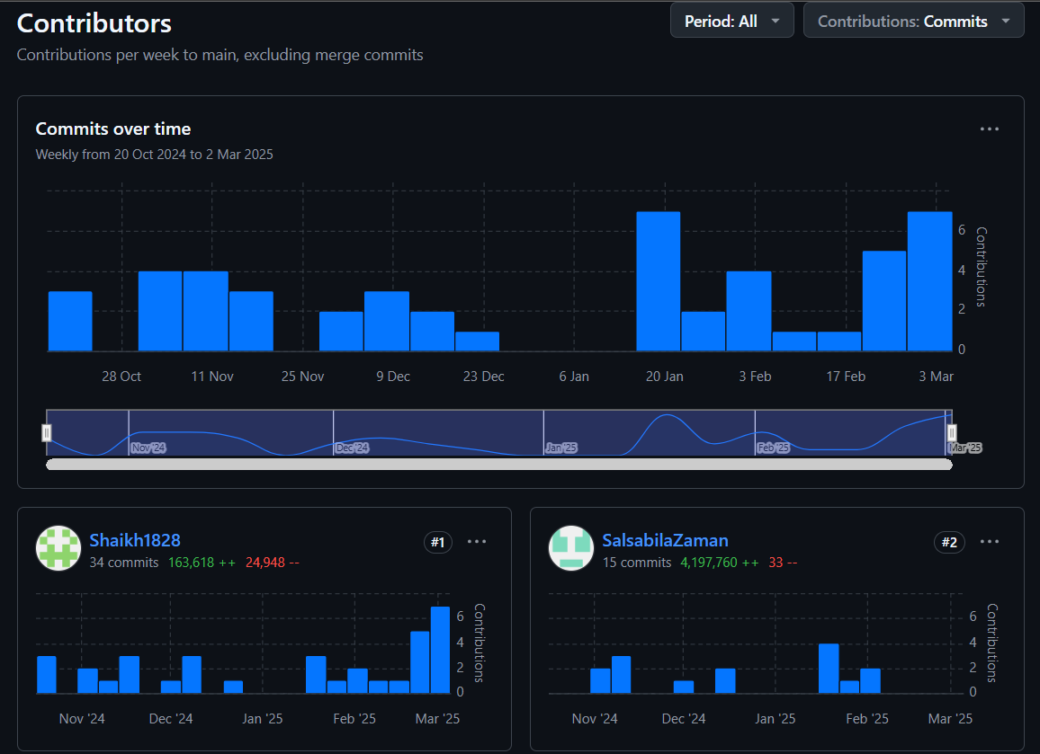
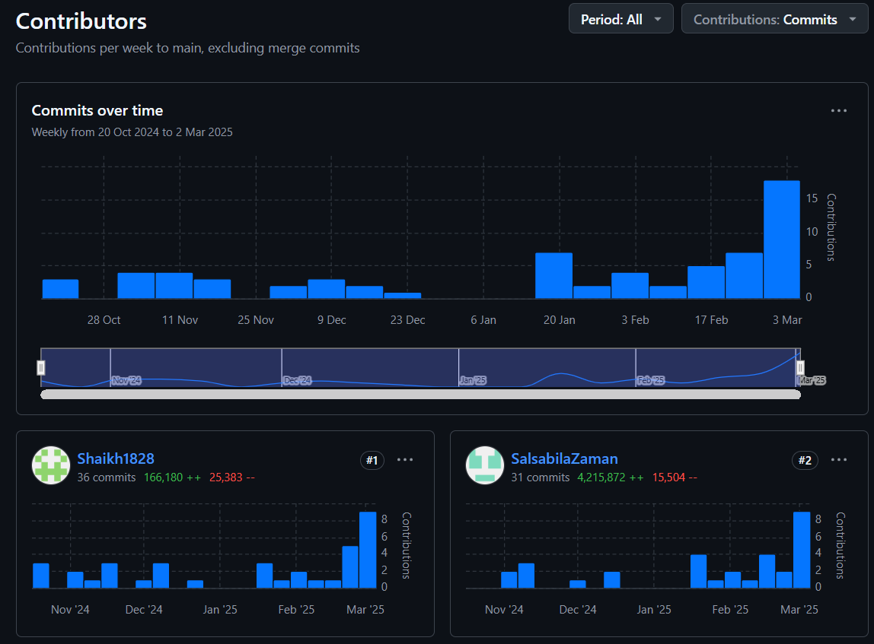
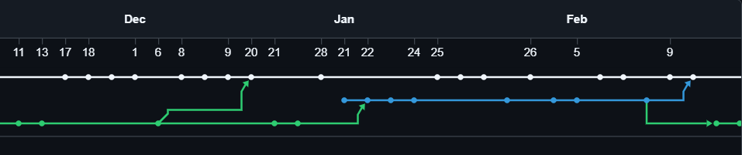
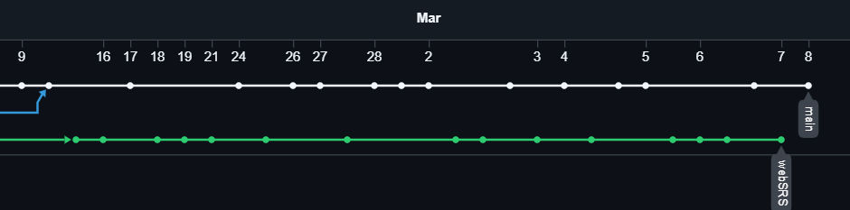
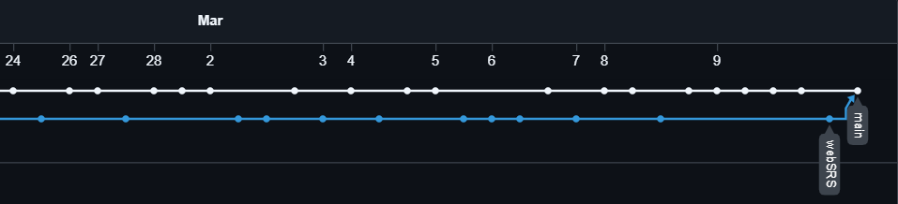
UNITY AND WORK
8

Slide 9





WHERE TO FIND DROID SCANNER
Application Link
Github Repository
Documentation
9

Slide 10
THANK YOU!
FOR YOUR ATTENTION
10

